Slide 1
Docker Swarm
What is Docker and Docker container?
What is Docker Swarm?
Features of Docker Swarm
Architecture of Docker Swarm
Architecture – How does Docker Swarm work?
Demo – How to create a service in Docker swarm

Slide 2
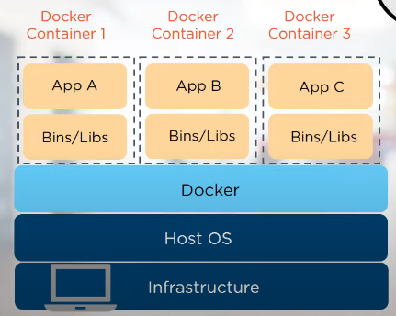
Docker
Tool for automating the deployment of an application as a lightweight container so that the application can work efficiently in different environments

Slide 3
What is Docker Swarm?
Docker Swarm is a service which allows users to create and manage a cluster of docker nodes and scheduled containers
Each node of a Docker swarm is a Docker daemon and all docker daemons interacts using the Docker API
Here services can be deployed and accessed by nodes of same cluster

Slide 4
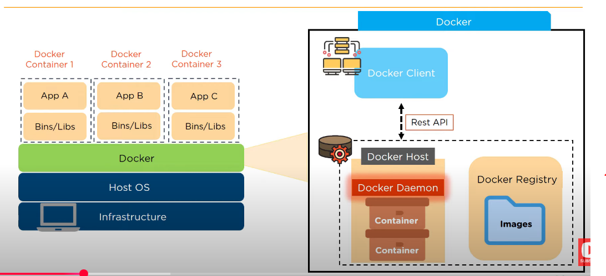
What is Docker Swarm?

